Slide 1

MSU Data Analytics Bootcamp
June 2022 Cohort
Final Project
G7 – FKA “The-Travel-Agents”
Kelly McQuillan
Jon May
Jordan White
Erika Wilson
June 1, 2022
Notes:
Erika

Slide 2
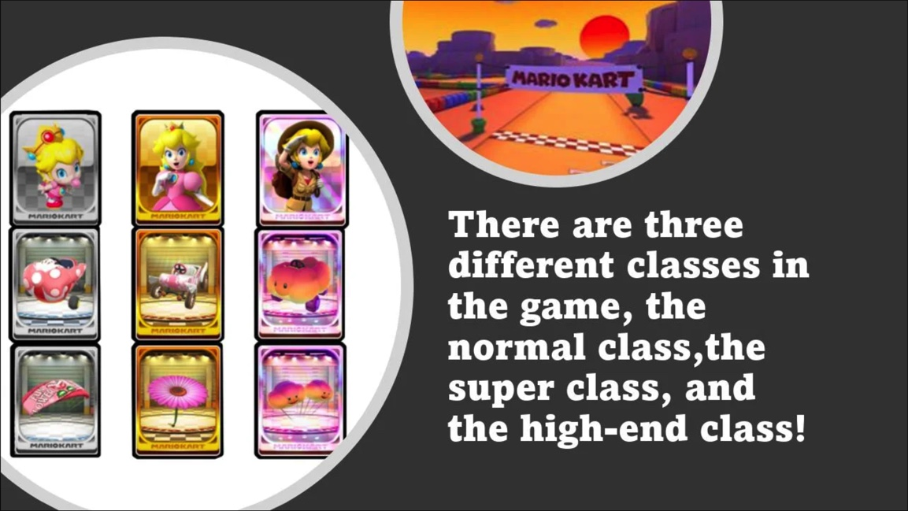
Agenda
Project Intro
Hypothesis
Process
Demo
Gotchas
Questions
Notes:
Erika

Slide 3

Notes:
Jon

Slide 4
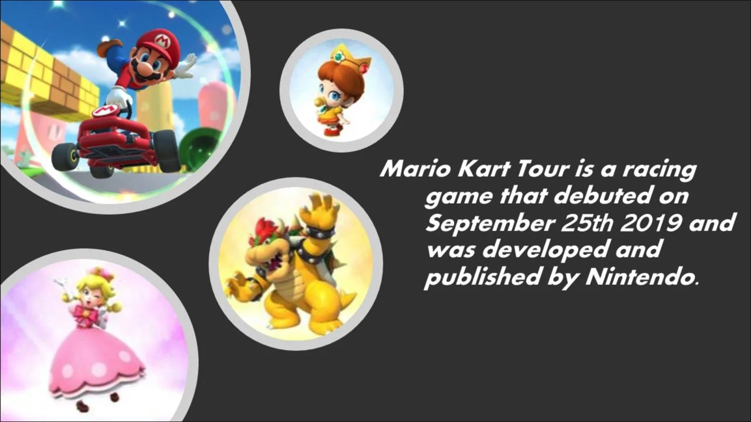
Hypothesis
To ….
Notes:
Kelly

Slide 5
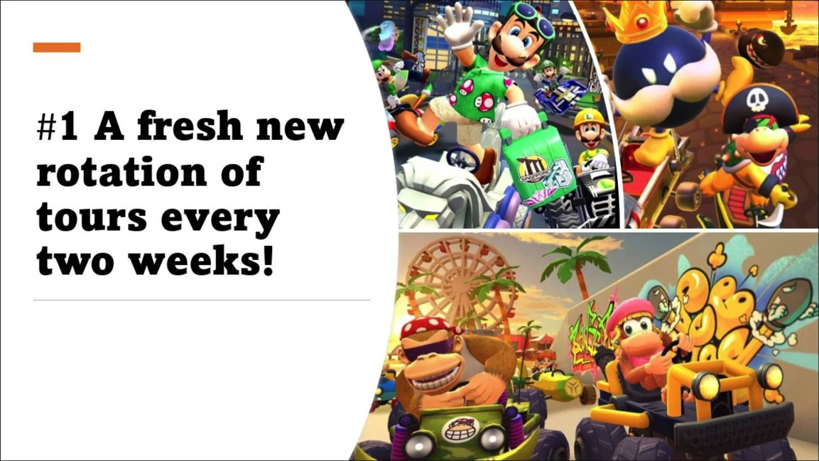
Process
Dataset
Database
Models
Website
Notes:
All

Slide 6
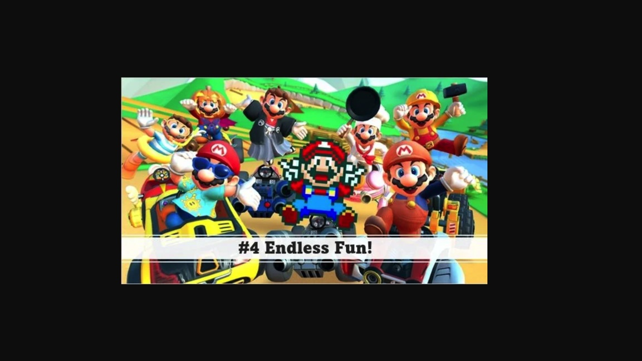
Machine Learning Models

Slide 7
Model 1

Slide 8
Model 2

Slide 9

Demo

Slide 10
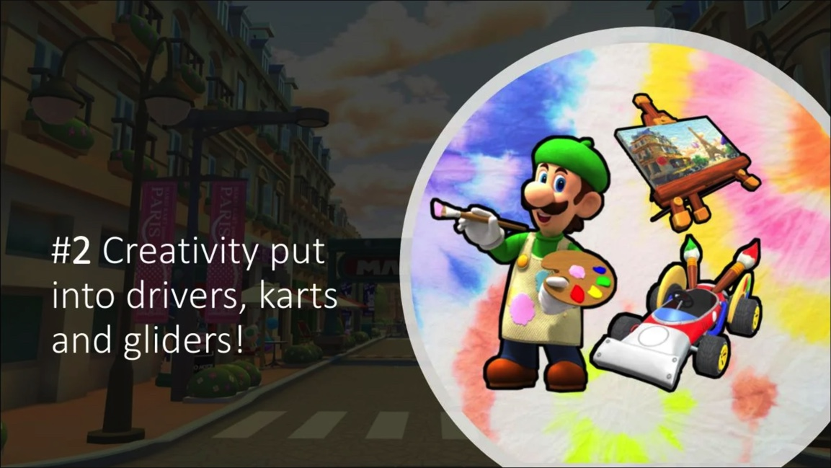
Gotchas
Notes:
Jordan

Slide 11

What questions do you have?

Slide 12
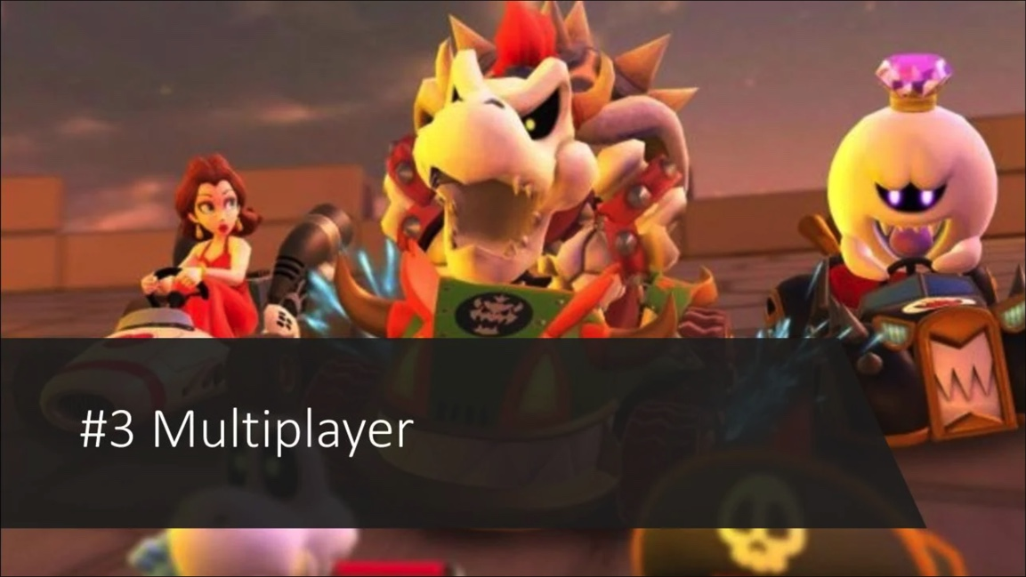
Thank you!!!

Slide 13
